Slide 1
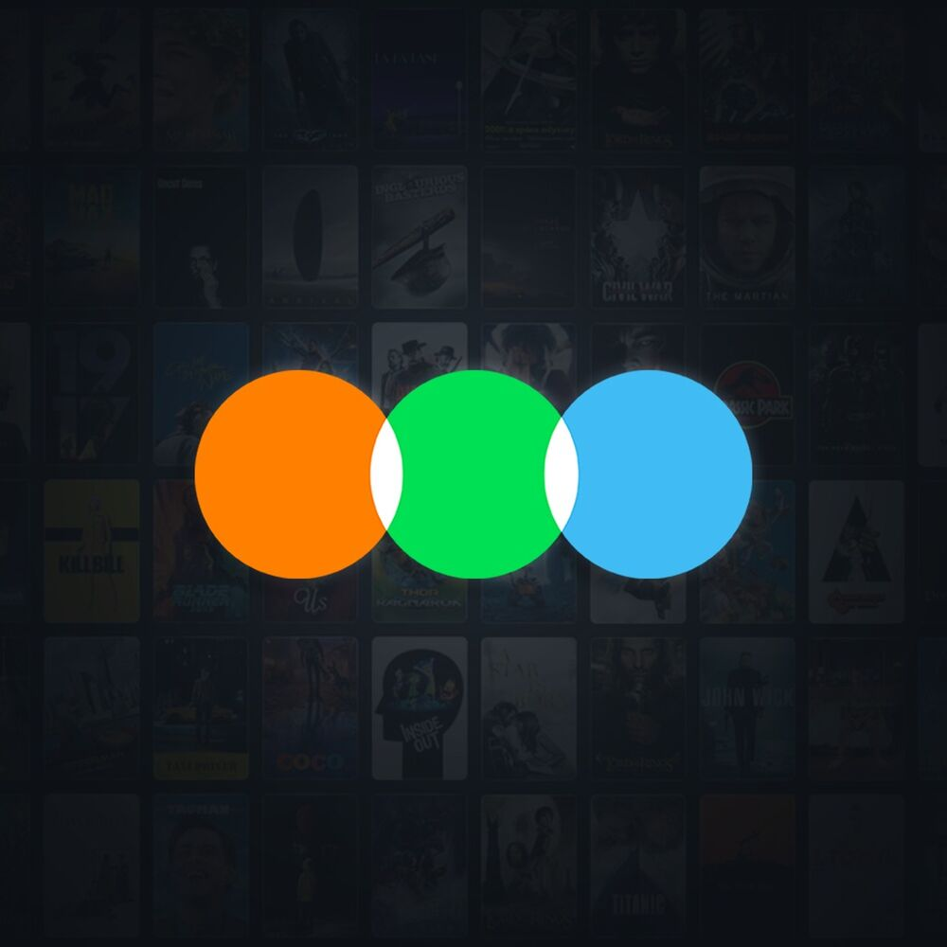
Letterboxd Movie Intelligence Report
A Data-Driven Deep Dive into Popularity, Quality, and Strategy
By: Aditya Dutta Tools Used: Python (Pandas, Seaborn, XGBoost, NLTK), Power BI

Slide 2
Dataset Overview
Business Problems & Key Questions
Technical Approach & Challenges
Dashboard, Audience Insights, Genre Engagement and Sentiments
Strategic Insights (10 Questions Answered)
Summary & Recommendations
Contents

Slide 3
Dataset Description
We used the Letterboxd Movie Classification Dataset (Kaggle), containing over 9,000+ films with metadata like:
Film Title, Description, Runtime
Average Rating, Total Watches, Likes, Fans
Genres, Studios, Director
Original Language
Breakdown of 1★, 3★, 5★ ratings

Slide 4
Data Cleaning & Preparation
We enriched the dataset by:
Cleaning and parsing genres/languages
Creating popularity and quality segments
Running sentiment analysis on descriptions
Building clustering, classification & regression models
Developing a recommender system

Slide 5
Business Problems & Key Questions
Letterboxd, as a social film platform, needs to optimize:
User Engagement: What makes a movie popular?
Quality Metrics: Can we predict what critics will love?
Genre Strategy: Are we ignoring valuable niche films?
Recommendation UX: Can we improve personalized content?
Investment Strategy: What metadata signals success?

Slide 6
Technical Approach
We tackled this through:
EDA: Language, genre, studio trends
Visualizations: Distribution, bar charts, scatterplots, boxplots
Modeling:
Regression (XGBoost): Predict average rating
Classification (XGBoost): Predict quality band
Clustering (KMeans): Segment films
NLP: TF-IDF for recommendations + Sentiment analysis
Power BI Dashboard: 4 Pages — KPIs, Engagement, ML, Clustering

Slide 7
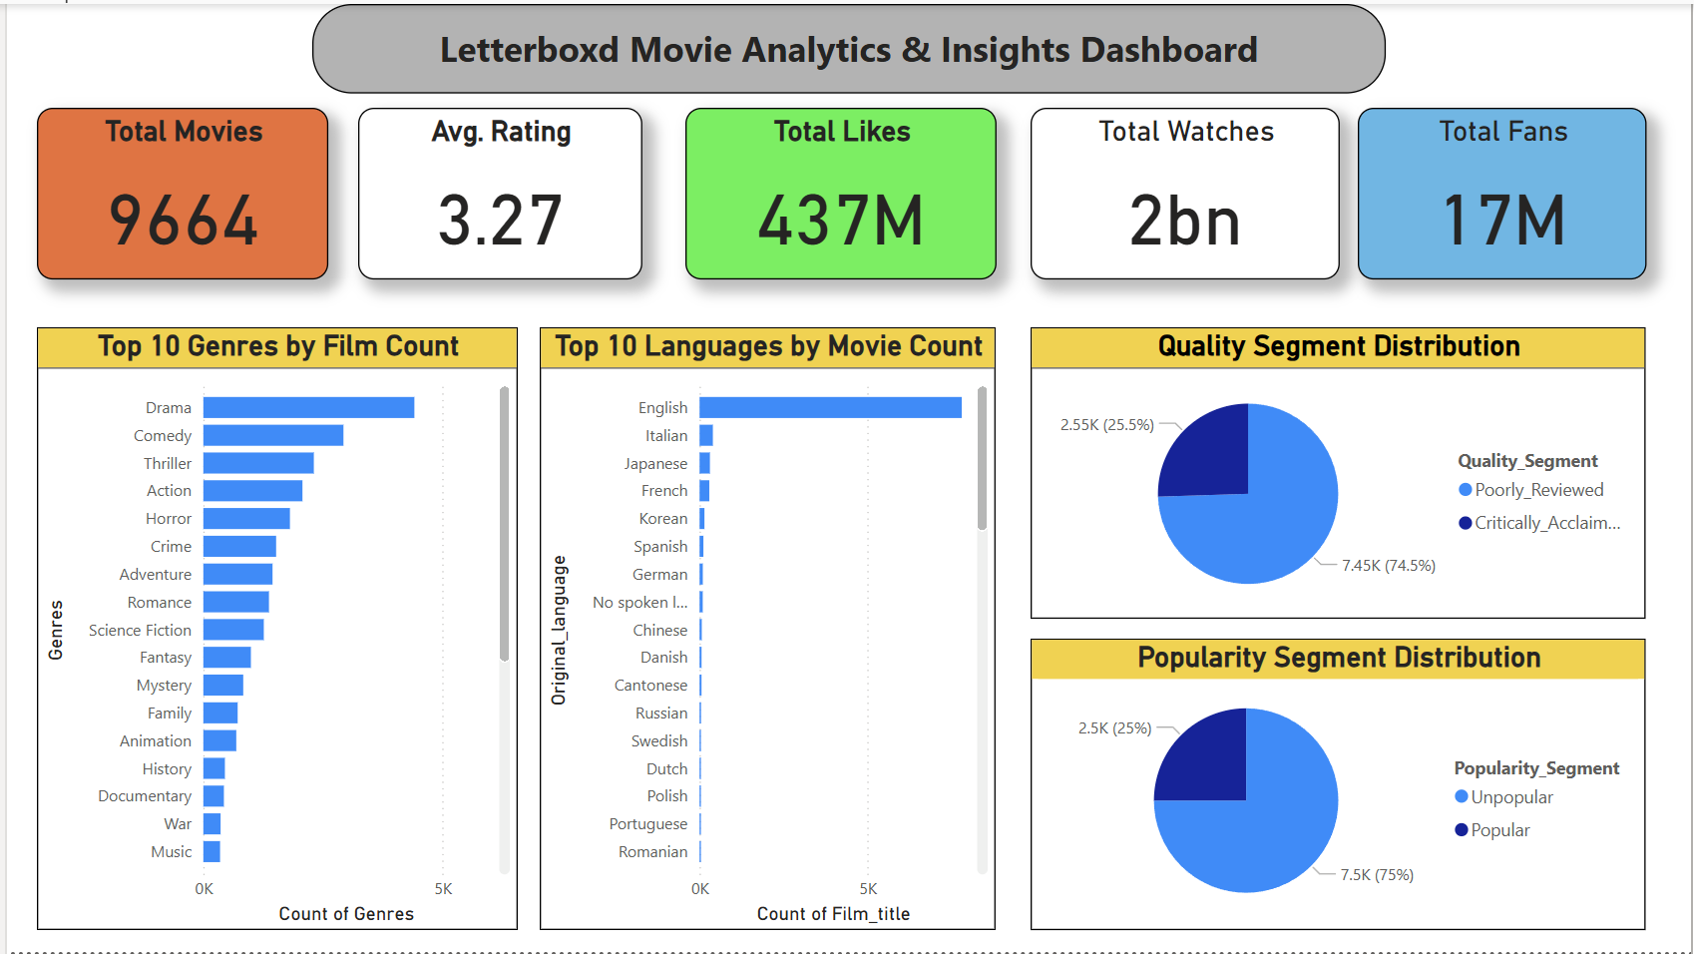
Overview ( Power BI screenshots)

Slide 8
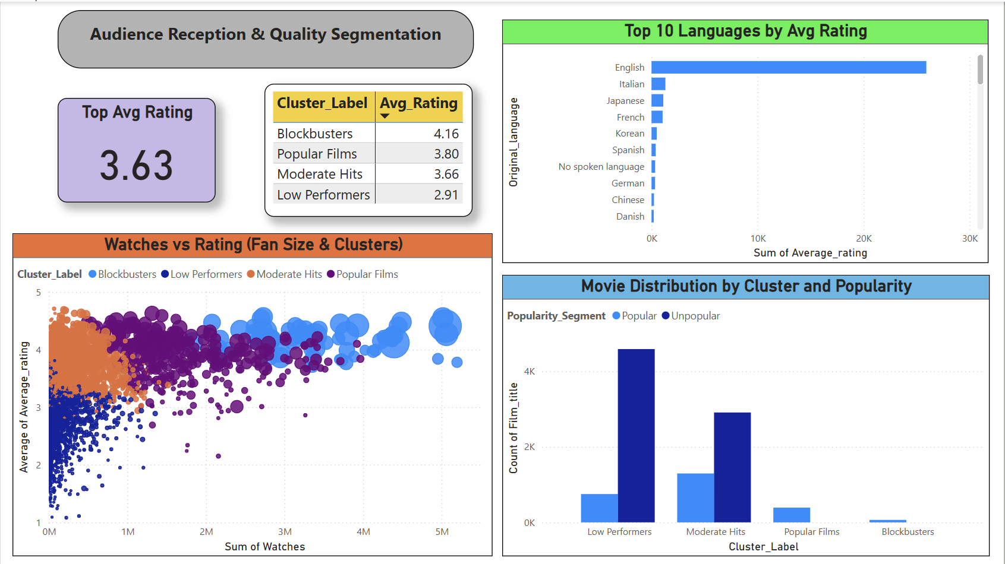
Audience Insights

Slide 9
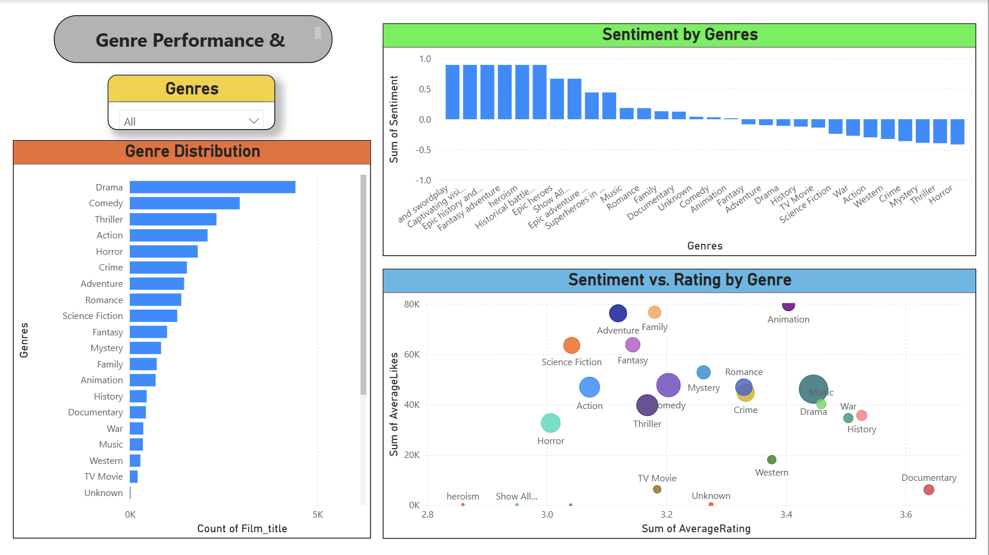
Genre Engagements & Sentiment Based on Descriptions

Slide 10
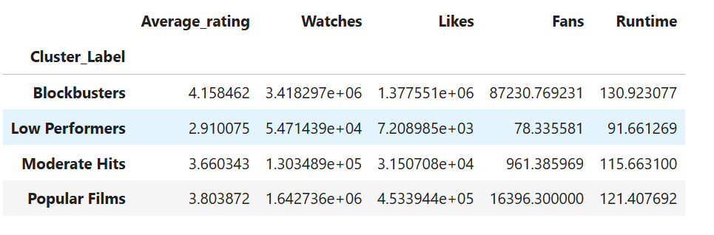
Q1: What traits define a blockbuster film?
Insight: Blockbusters tend to have: Higher runtime, Large fan counts and likes, Above-average watches

Slide 11
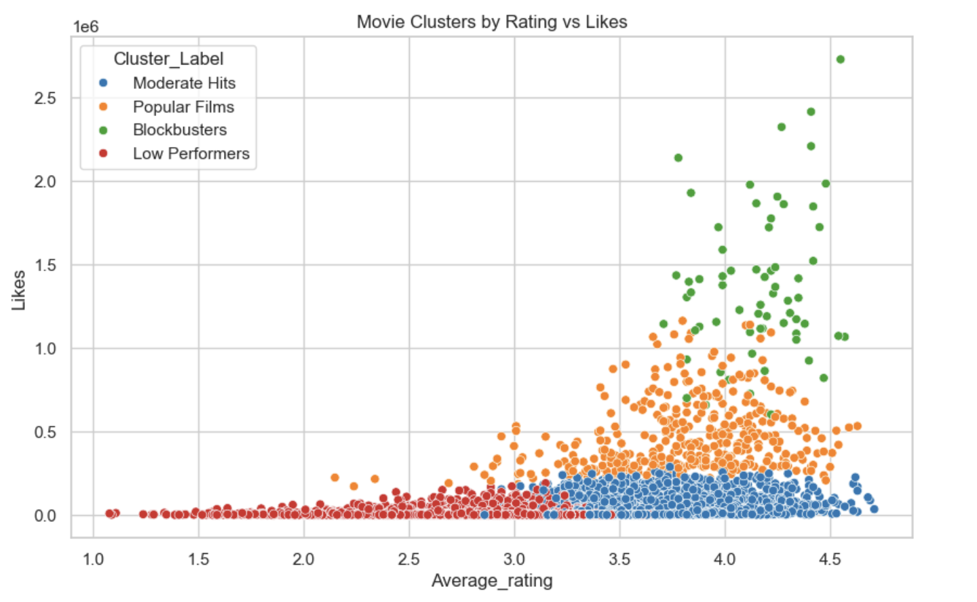
Movie Clusters by Ratings vs Likes

Slide 12
Key Findings: Blockbusters consistently fall into a distinct cluster characterized by:
High Likes and Fan counts
Above-average Runtime
Strong performance across engagement metrics (Watches, List Appearances)
These traits sharply differentiate them from low-performing or niche films.
Business Use Case
Use these insights to:
Forecast early-stage films with blockbuster potential by checking for alignment on these traits
Prioritize distribution or homepage promotion for titles matching this cluster

Slide 13
Strategic Recommendation
Create a “Trending Blockbuster Picks” carousel for the homepage featuring films from this cluster — it will likely boost both watch time and user engagement.

Slide 14
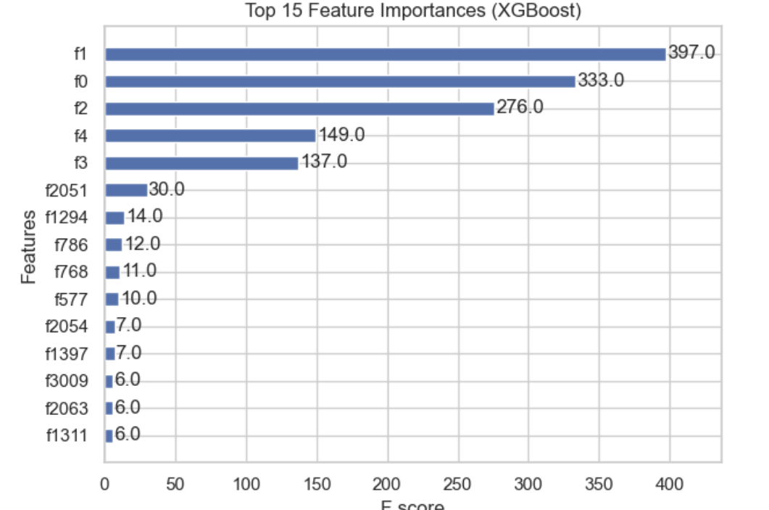
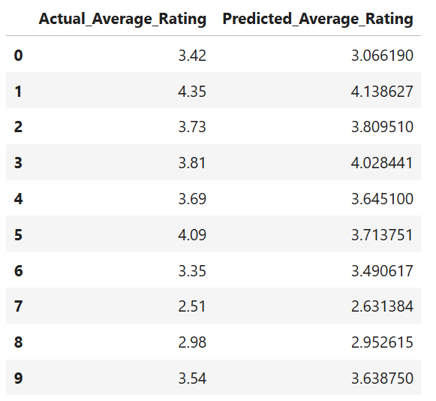
Q2: How Well Does Metadata Predict Film Success Pre-Release?
Source: XGBoost Regression Model on Metadata
(Features: Genre, Director, Studio, Runtime, Language, Watches, Likes, Fans, List Appearances)

Slide 15
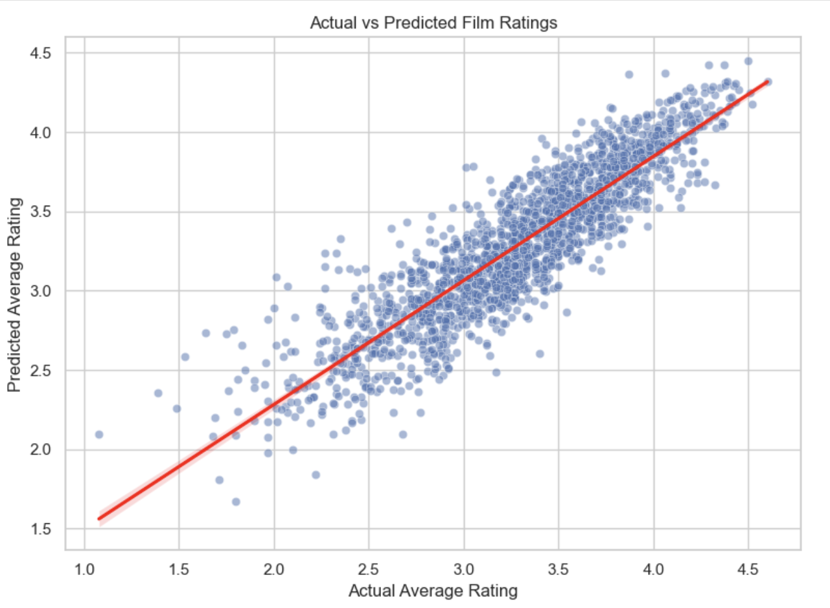
Actual VS Predicted Film Ratings Scatterplot

Slide 16
Key Findings :
The regression model achieved:
R² Score ≈ 0.80 → 80% of the variance in average ratings can be explained by metadata
Top Predictive Features:
Likes
Fans
Specific Genres
Director & Studio encoded with high importance

Slide 17
Business Use Case
Greenlighting & Budget Allocation: Before release, use metadata to predict reception and confidently allocate promotional budget
Early Quality Flags: Detect likely underperformers for creative intervention or repositioning
Strategic Recommendation
Integrate this model into the content acquisition pipeline — enable studio partners to test scripts or metadata-based pitches against this tool.

Slide 18
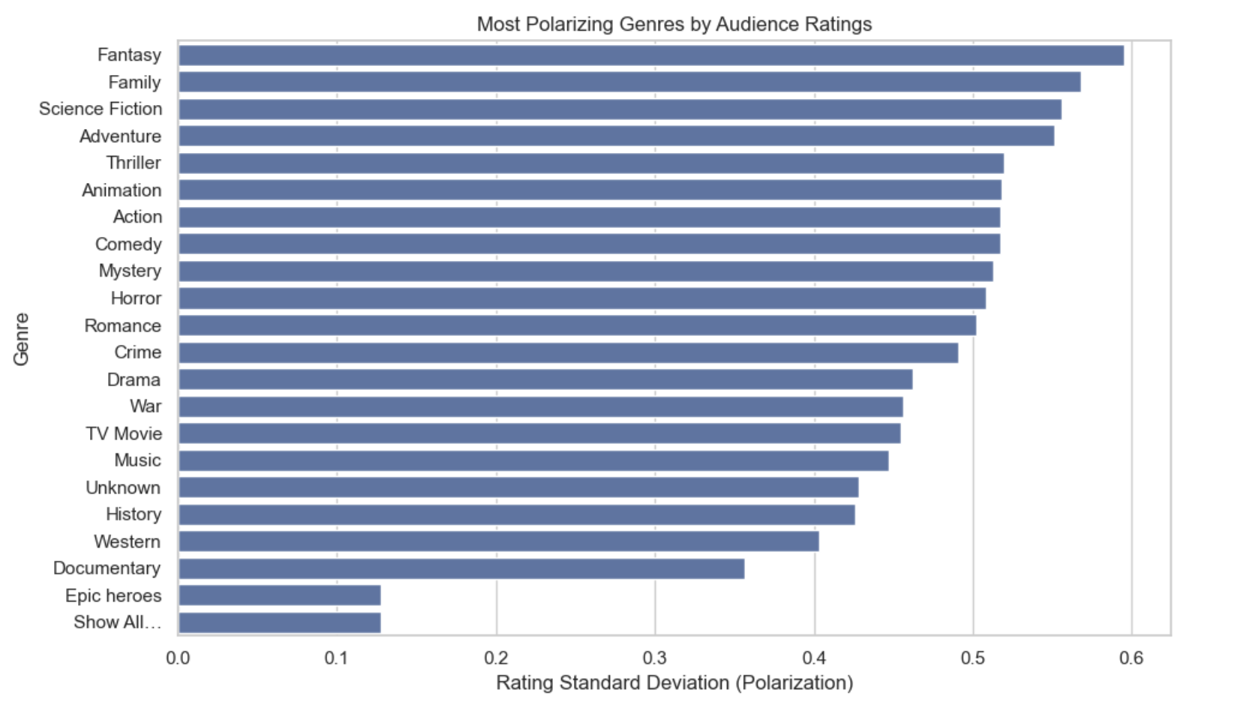
Q3: Which Genres Are Most Polarizing?
Source: Standard Deviation of Ratings by Genre
(Computed from Average_rating distribution within each genre)
Standard Dev of Ratings by Genre

Slide 19
Key Findings
Genres with Highest Rating Variance:
Fantasy, Family, and Adventure genres exhibited the widest spread of audience ratings.
These genres often attract niche or passionate audiences, leading to either high praise or strong criticism.
Conversely, genres like Drama and Documentary had tighter rating distributions, indicating more consistent audience perception.

Slide 20
Business Use Case
Marketing Strategy:
For polarizing genres, segment audience targeting more precisely (e.g., tailor trailers and social media to superfans).
UX Personalization:
Recommend such content to users with matching historical sentiment patterns or genre affinity.
Partnerships & Funding Decisions:
Exercise creative caution or refinement in polarizing genres unless a proven talent (director/studio) is involved.
Strategic Recommendation
Use genre-level variance to tag titles as "broad-appeal" vs "niche-risk" and adjust promotional effort, platform placement, and recommendation aggressiveness accordingly.

Slide 21
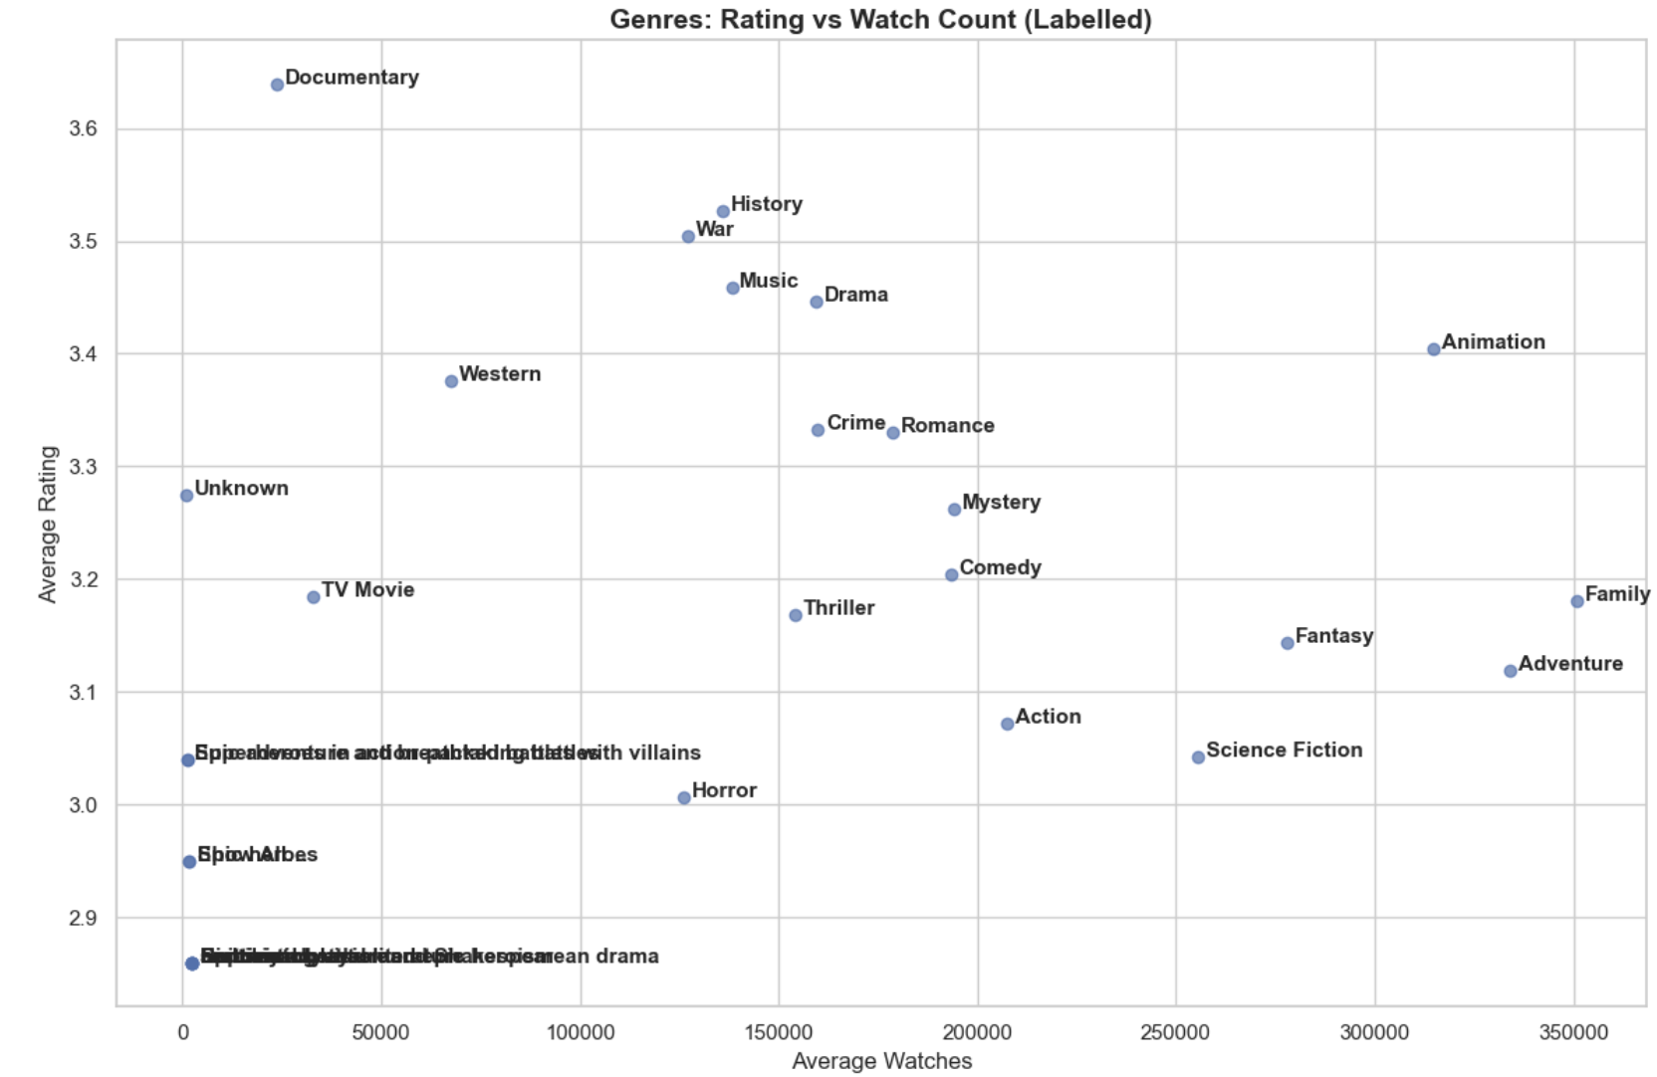
Q4: What Genres Are Undervalued but High-Quality?
Aggregated Average_rating and Watches per genre.
Filtered out genres with extremely low movie counts to reduce noise.
Created a scatter plot of Average Rating vs Average Watches, labeling the genres.
Rating vs Watch Count Plot

Slide 22
Key Findings :
From the scatterplot:
Documentary, History, Music, War:
Have above average ratings (3.4–3.6).
But relatively low watch counts.
These genres are critically appreciated but under-viewed.
Animation, Adventure, Family: High watch count and strong average ratings → Already mass-market successes.
Fantasy, Action, Sci-Fi, Thriller:
Popular but average-to-low rating genres — wide appeal but polarizing quality.
Horror:
High visibility but lowest average rating — potential overproduction in this segment.

Slide 23
Business Use Case
This analysis surfaces “Hidden Gem Genres” — content areas with high quality but low reach.
These genres:
Can be featured in editorial promotions (“Critically Acclaimed, Overlooked Films”).
Offer curation value to cinephiles.
Can guide platform recommendation tweaks to introduce users to high-quality niche content.
Strategic Recommendation
Elevate underappreciated genres like Documentary, War, and History through:
Homepage features
Recommendation weighting
Thematic lists or campaigns (e.g., “Truth in Film” week)
Partner with studios known for high-quality genre films (e.g., indie documentary producers).
User Retention: Offering well-reviewed but less-seen films increases the value for returning users tired of mainstream content.

Slide 24
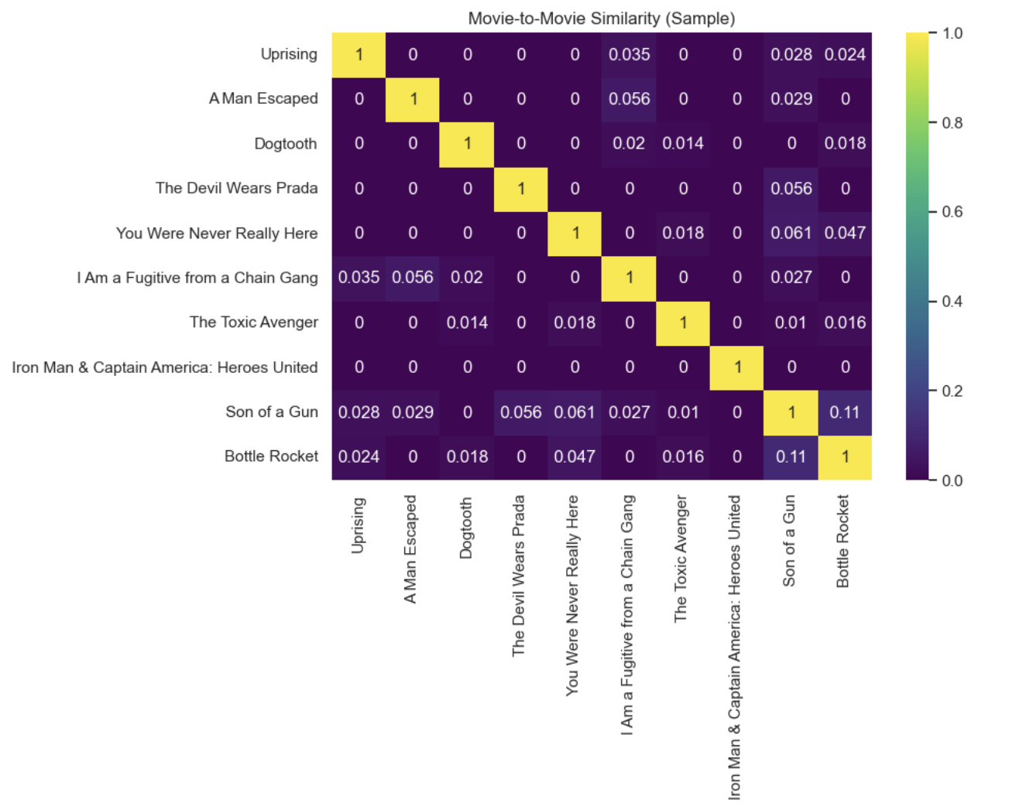
Q5: Can we personalize recommendations by genre/language?
Yes — we built a content-based recommender system using TF-IDF on movie descriptions + cosine similarity to suggest similar films. These recommendations can be filtered or prioritized by genre, language, or quality segment. In the similarity matrix, each cell shows how similar two movies are based on their descriptions.
Bright yellow = highly similar. These scores drive personalized suggestions.
Similarity Matrix

Slide 25
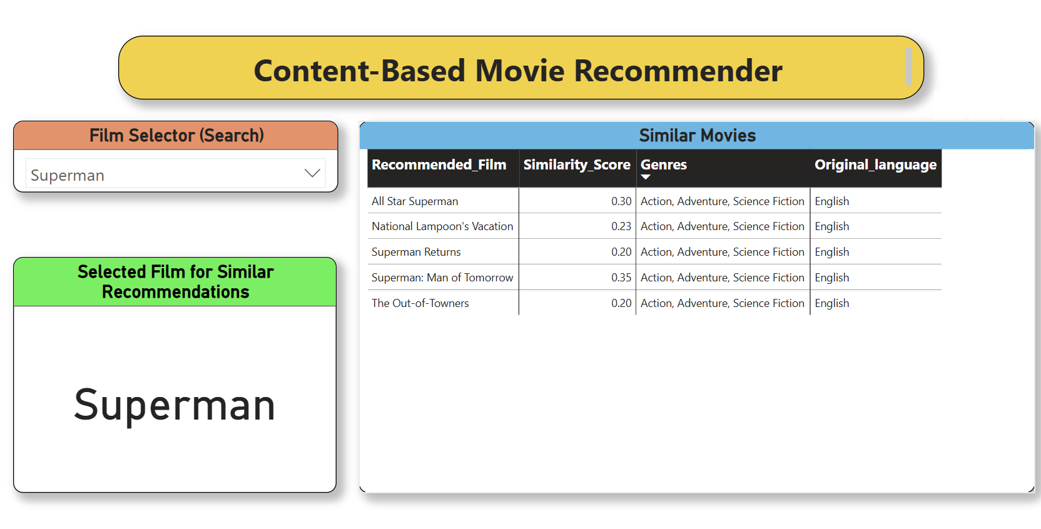
Working Movie Recommendation System

Slide 26
Key Findings
Movies with similar plots have strong cosine similarity — great for follow-up suggestions.
Combined with metadata (e.g. language, genre), recommendations can be made more relevant and localized.
Sentiment and popularity tags (e.g., “Blockbusters”, “Critically Acclaimed”) add additional filters.
Business Use Case
Enables personalized discovery: users get similar films in genres/languages they prefer.
Boosts watch time and engagement retention by offering smart suggestions immediately after viewing.
Enhances user satisfaction, reducing bounce rates from aimless browsing.

Slide 27
Strategic Recommendation
Integrate this recommender into Letterboxd’s UX — show “Because you liked X...” with filters.
Allow users to refine recommendations by genre (e.g., “Sci-Fi like Interstellar”) or language (e.g., “Spanish-language thrillers”).
Promote lesser-known but similar titles — especially hidden gems with high sentiment.

Slide 28
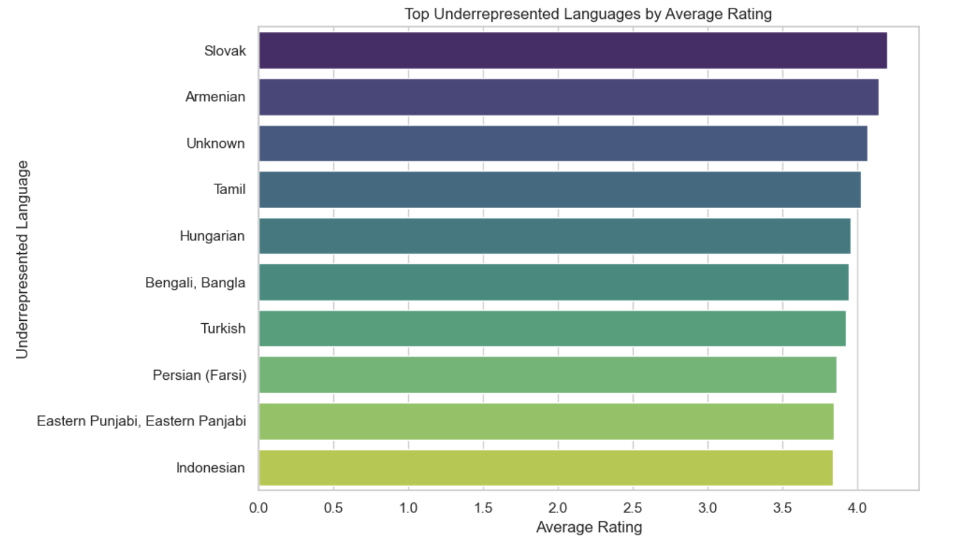
Q6: Which Underrepresented Languages Show High Average Ratings?
Analysis of films grouped by Original Language, filtered to show languages with low watch count but high average ratings.

Slide 29
Key Findings
Top underrepresented languages with consistently high ratings include:
Slovak, Armenian, Tamil, Hungarian, and Bengali.
These languages receive less exposure (fewer total views) yet outperform mainstream languages in average rating.
Indicates strong content quality in regional or niche cinema that is currently underleveraged.
Strategic Use Case
Promotional Strategy: Spotlight films from these languages on curated lists or homepage banners.
Global Expansion: Identify markets (e.g. Armenia, Slovakia) for platform growth or partnerships with regional studios.
Recommendation Engine: Boost these high-quality, low-visibility films in personalized recs to diversify user experience.

Slide 30
Business Impact
Helps retain cinephile users seeking niche or international cinema.
Opens up cross-cultural content promotion pathways and long-tail engagement opportunities.

Slide 31
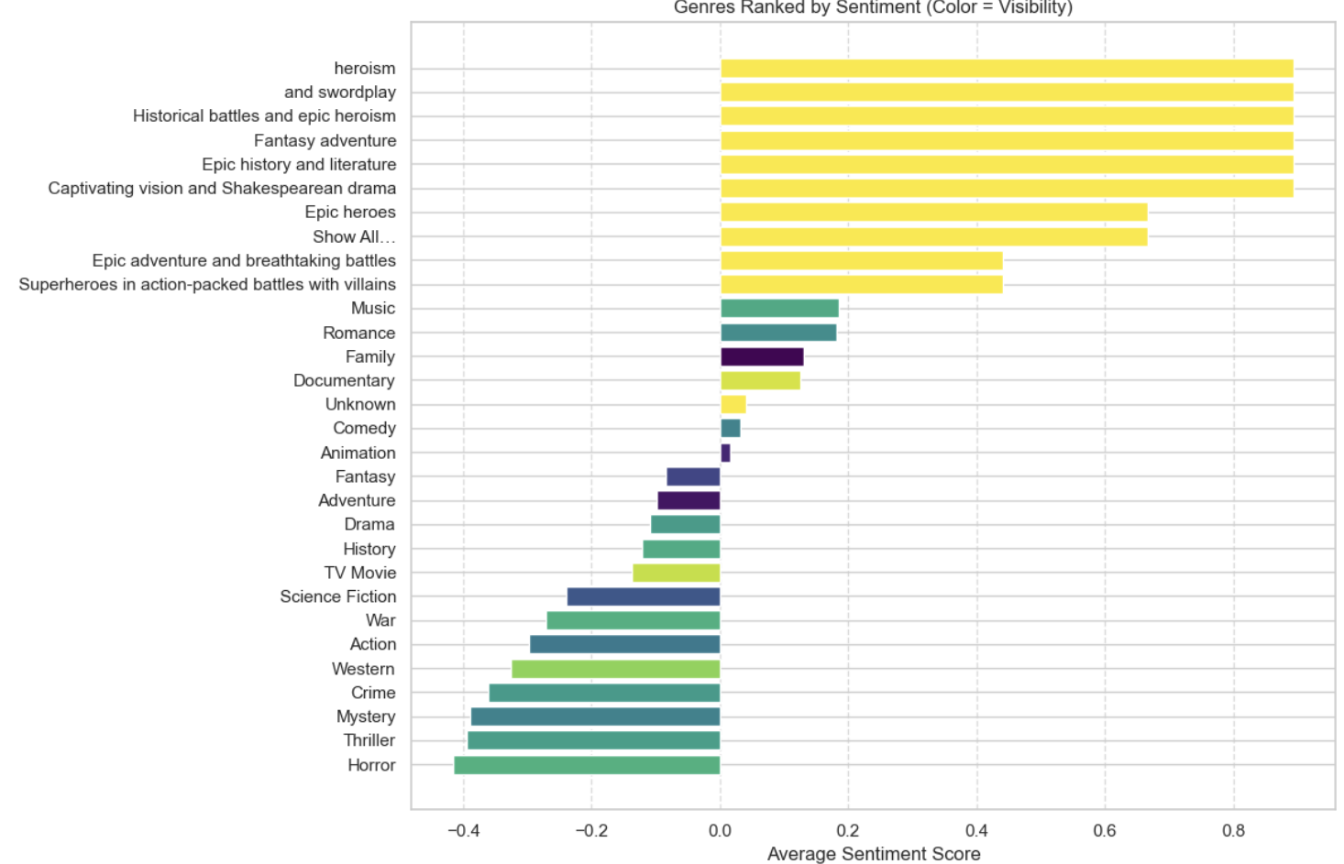
Q7: Which genres combine high sentiment AND low visibility?
Some genres resonate deeply with audiences (high sentiment) but receive relatively low attention or viewership. Identifying these can guide promotion and investment strategies.
Genres Ranked by Sentiment

Slide 32
The horizontal bar chart above shows genres ranked by average sentiment, with bar color representing visibility (based on average watches).
Yellow bars: High watch count (high visibility)
Darker bars: Low watch count (low visibility)
Key Findings
Genres like "Documentary" and "Family" receive strong audience sentiment yet appear less watched.
High-sentiment thematic clusters like "Epic history", "Fantasy adventure", and "Heroism" also show varying degrees of low-to-moderate visibility.

Slide 33
Business Use Case These genres are emotionally impactful yet underwatched — perfect candidates for strategic promotion. By surfacing these films to more users (e.g., featured carousels or email campaigns), platforms like Letterboxd can boost user engagement and discoverability.
Strategic Recommendation
Develop curated playlists around "Hidden Emotional Gems".
Use sentiment + visibility filters in recommender systems.
Invest in content partnerships for overlooked yet high-impact genres like Documentary and Historical Fantasy.

Slide 34
Summary & Recommendations
Suggested Next Steps for Letterboxd
Use cluster segments to launch targeted recommendation emails
Boost promotion of high-sentiment but low-view genres
Use predicted quality scores for unreleased film validation
Localize experience by top-performing underrepresented languages
Create a "Director/Studio Spotlight" feature for engagement
Key Wins
Built 3 ML models (Classification, Regression, Clustering)
Created actionable audience and content segmentation
Identified promotional & partnership opportunities
Delivered Power BI dashboard with 4 insight-packed pages

